Slide 1


EFFECTIVENESS OF STATE POLICY ACTIONS TO ADDRESS COVID-19
CSP571 Project Report

Slide 2
MEET THE TEAM
Kacper Malysa
Fourth-Year
BS-AMATH
Co-Terminal:
BS-CS
MS-DS
Mingxi Xia
Fourth-Year
Co-Terminal:
BS-Accounting
MS-CS
Roman Sydorchuk
Fourth-Year Co-Terminal:
BS-CS
MAS-DS
Spencer Sumner
Fourth-Year
PhD
Industrial
/Organizational
Psychology
Yurun Liu
Fourth-year
Co-Terminal:
BA-Math and CS
MS-Data Science

Slide 3
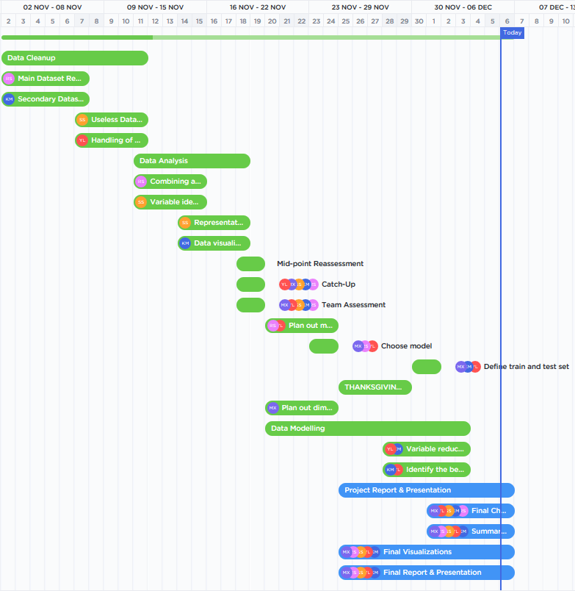
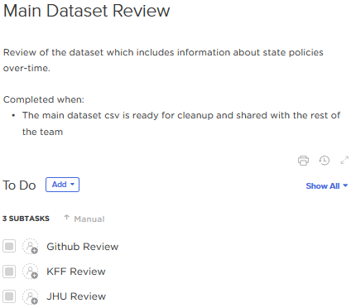
OUR PROCESS

Slide 4
EXECUTIVE SUMMARY
The Issue
The mass spread of COVID-19 throughout the U.S.
Our Objective
To identify the most effective public policies for fighting the spread of COVID-19.
Why?
Health impacts
Economic impacts
Our findings
Workplace closures, stay-at-home orders, and closing public transportation showed the greatest effects.

Slide 5
LITERATURE OVERVIEW
COVID-19 has provoked sweeping public health responses
Policies have been implemented across the world with varying effects [5]
Our focus is on the U.S.
The effects of policies is difficult to track across 50 states over time
Several policies have previously been identified as effective
Workplace closures
Stay-at-home orders
Mask mandates
Caveats and confounds do exist
[1]-[10]

Slide 6
PROCESS OVERVIEW
On a weekly basis:
Analyze
Clean Data
Model
Project End
Project Start
Discuss

Slide 7
GETTING DATA ISN’T AS EASY AS ONE MIGHT THINK
John Hopkins University
&
Kaiser Family Foundation
John Hopkins University
&
University of
Oxford
C3 AI
COVID-19
Data Lake

Slide 8
GETTING DATA ISN’T AS EASY AS ONE MIGHT THINK
John Hopkins University
&
Kaiser Family Foundation
John Hopkins University
&
University of
Oxford
C3 AI
COVID-19
Data Lake

Slide 9
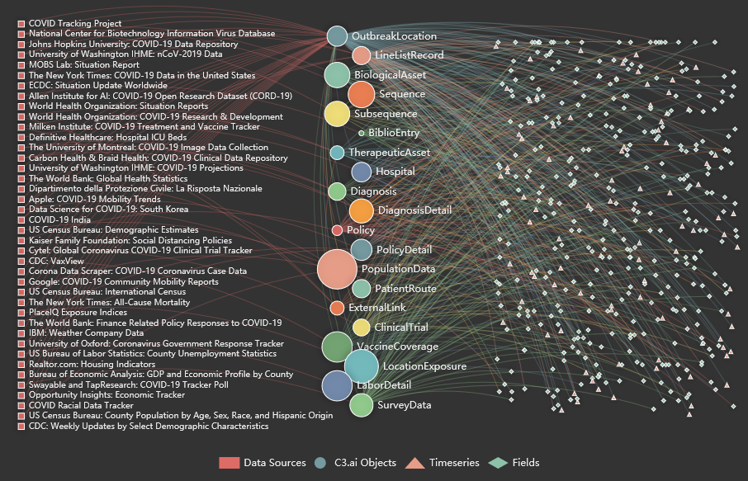
THE DATA LAKE SEEMS LARGE AND PROMISING...

Slide 10
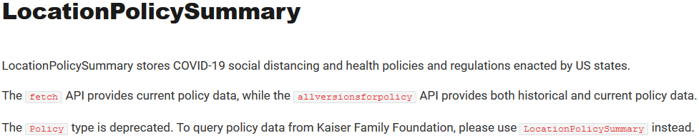
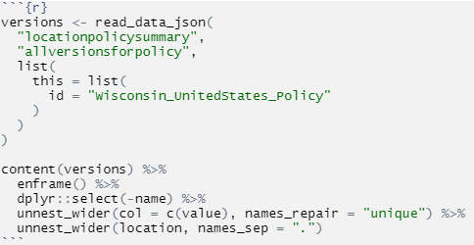
… BUT IN FACT IT’S QUITE SHALLOW

Slide 11
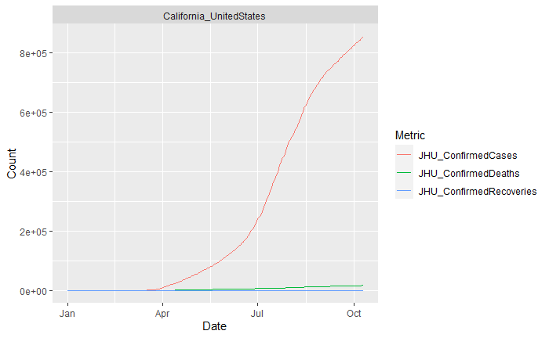
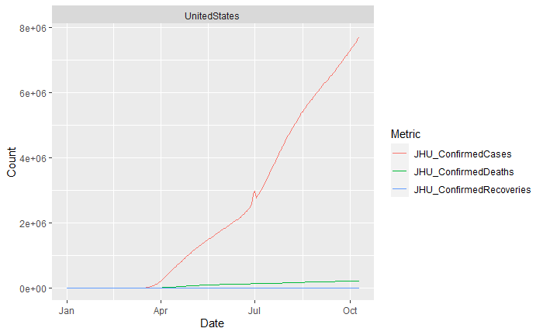
LACK OF ACCESSIBILITY OUTWEIGHS THE BENEFITS

Slide 12

LACK OF ACCESSIBILITY OUTWEIGHS THE BENEFITS

Slide 13
SLOWLY GETTING THERE...
John Hopkins University
&
Kaiser Family Foundation
John Hopkins University
&
University of
Oxford
C3 AI
COVID-19
Data Lake

Slide 14
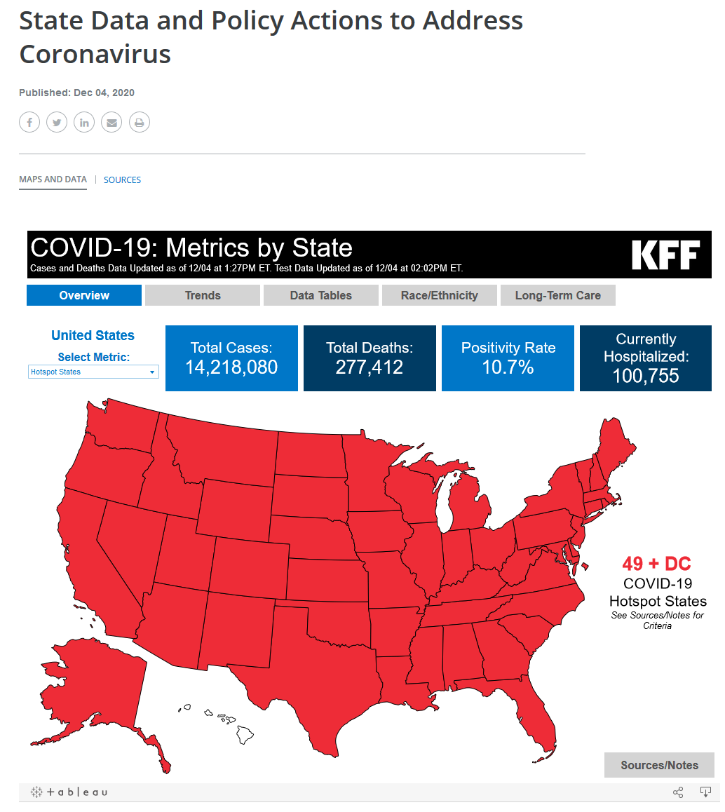
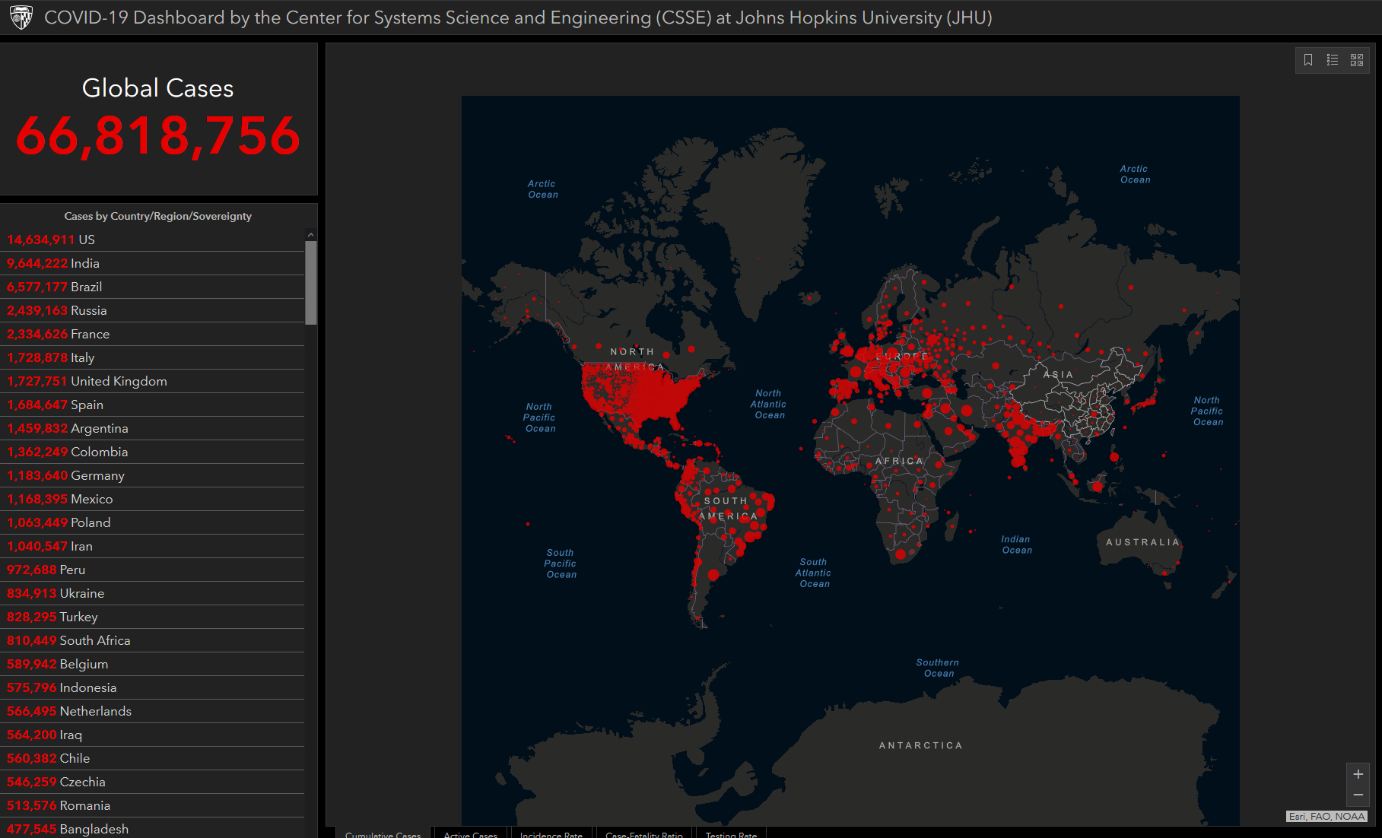
TIME TO FIND SEPARATE DATASETS FOR POLICIES AND STATISTICS

Slide 15
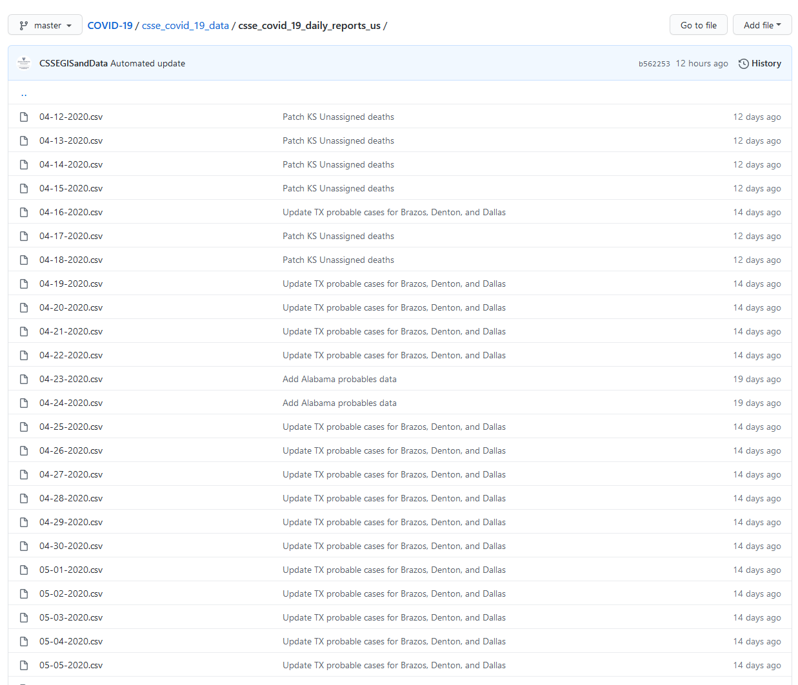
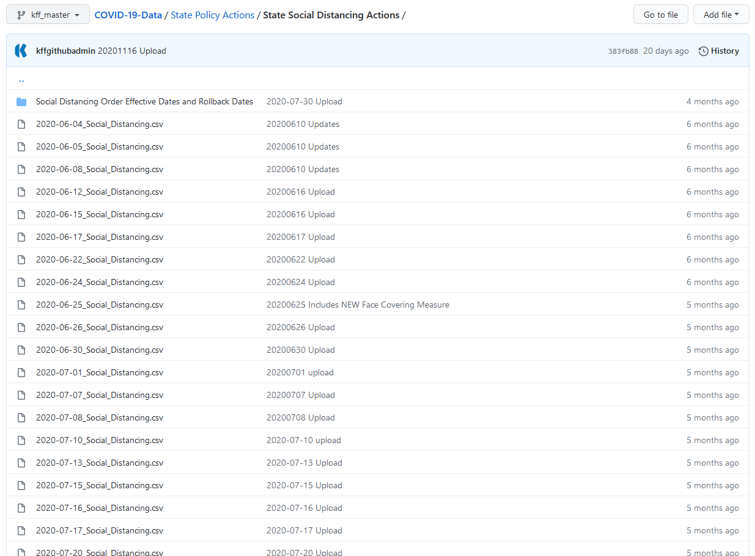
MOST COVID-19 RELATED DATA IS WELL DOCUMENTED
CSSEGIS
KFF

Slide 16
OBSERVATIONS AND VARIABLES
CSSEGIS
…
KFF
…

Slide 17
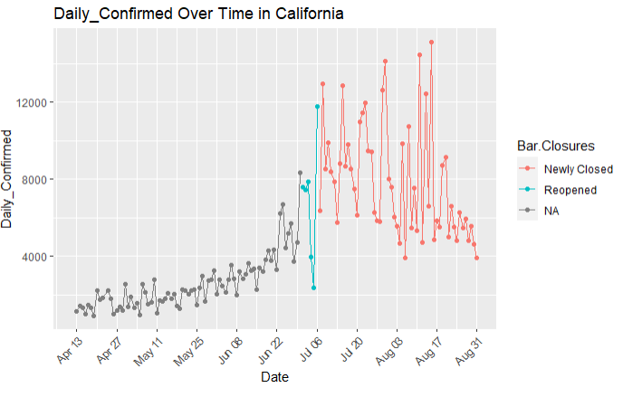
THESE TWO ALLOW FOR INSIGHTS, BUT WITH FEW ISSUES

Slide 18
THESE TWO ALLOW FOR INSIGHTS, BUT WITH FEW ISSUES

Slide 19
MOST COVID-19 RELATED DATA IS WELL DOCUMENTED
CSSEGIS
KFF

Slide 20
AND WE HAVE REACHED THE FINISH LINE!
John Hopkins University
&
Kaiser Family Foundation
John Hopkins University
&
University of
Oxford
C3 AI
COVID-19
Data Lake

Slide 21

UNIVERSITY OF OXFORD DATASET WAS THE FINAL PIECE
…
Now we can combine this with the John Hopkins University Data...

Slide 22
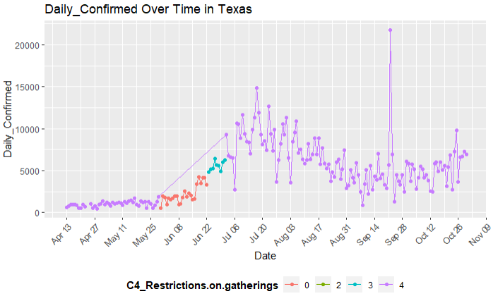
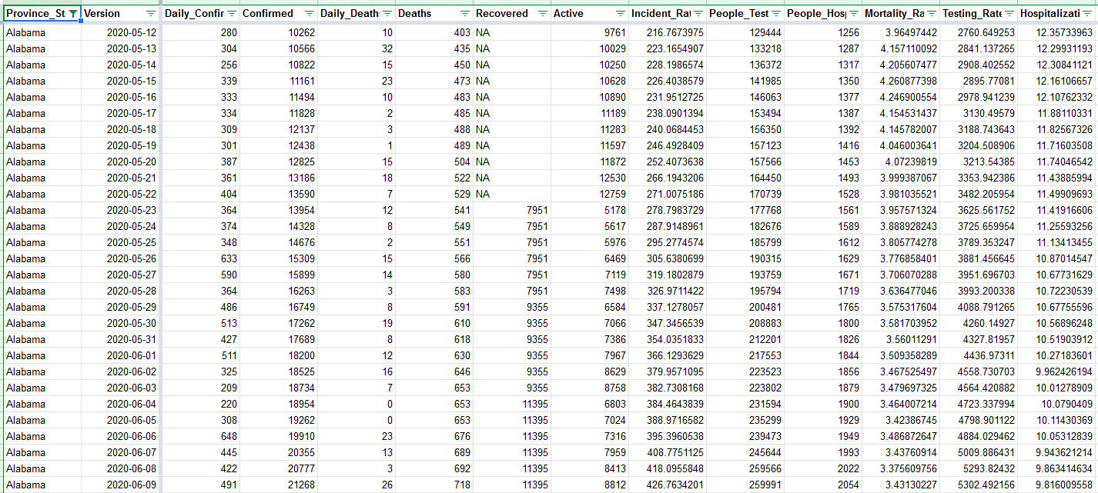
FINAL COMBINED DATASET
17757 observations
62 variables
Range: 04/12/2020 - 11/30/2020

Slide 23
INITIAL HYPOTHESES

Slide 24
INITIAL HYPOTHESES
High Severity
Lower Rate of Change
?

Slide 25
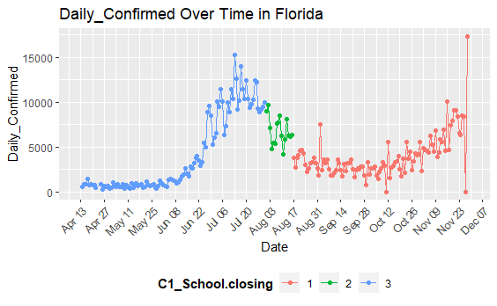
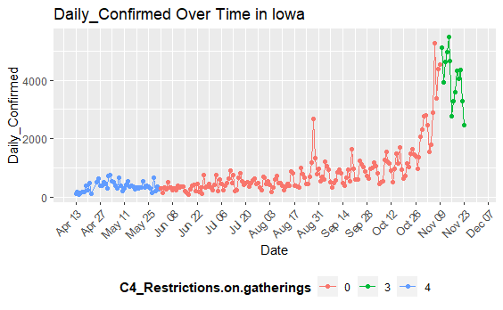
SOME VISUALIZATIONS SUPPORTED OUR CONJECTURE

Slide 26
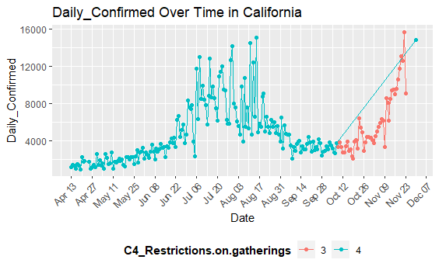
OTHERS NOT SO MUCH

Slide 27
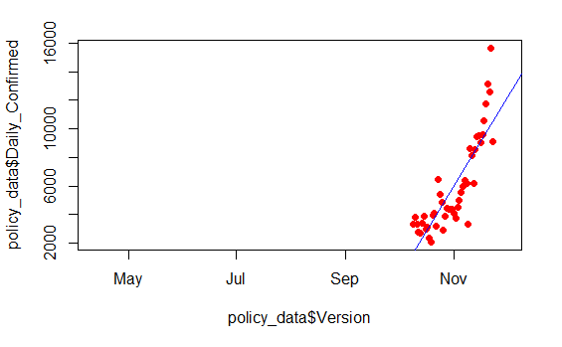
FIRST VERSIONS OF MODELING
Linear regression models
y = COVID Statistic
x = Date
for each policy
for each severity of policy
for each state

Slide 28
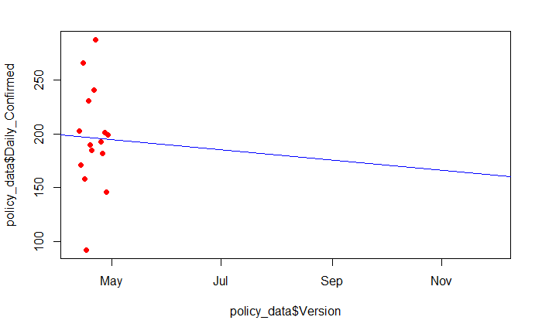
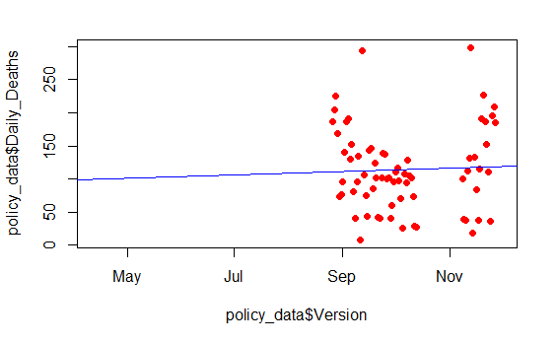
NOT ALL MODELS ARE VALID...

Slide 29
NOT ALL MODELS ARE VALID...
P-Value > 0.7!

Slide 30
NOT ALL MODELS ARE VALID...
P-Value > 0.7!
P-Value > 0.95!

Slide 33


Slide 34
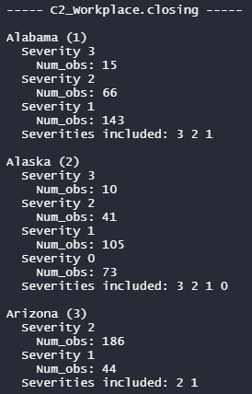
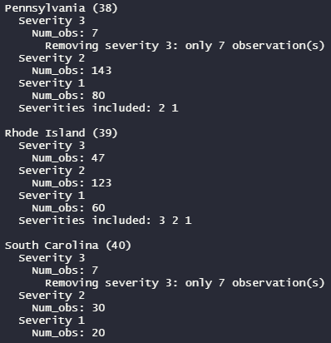
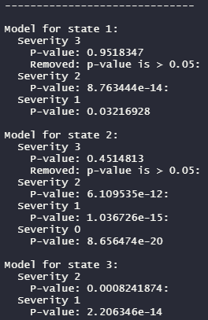
...MORE DATA CLEANING!

Slide 35
...MORE DATA CLEANING!

Slide 36
...MORE DATA CLEANING!

Slide 37
...MORE DATA CLEANING!

Slide 38

COMBINING THE MODELS - EXAMPLE
Policy: C2_Workplace.Closing
Statistic: Daily_Confirmed Cases

Slide 39
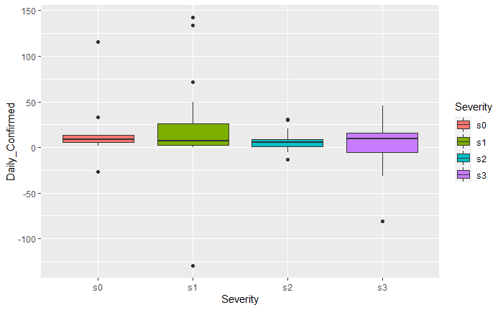
LOOKING AT SPREAD OF RESULTS

Slide 40
LOOKING AT SPREAD OF RESULTS

Slide 41
LOOKING AT THE SPREAD OF RESULTS

Slide 42
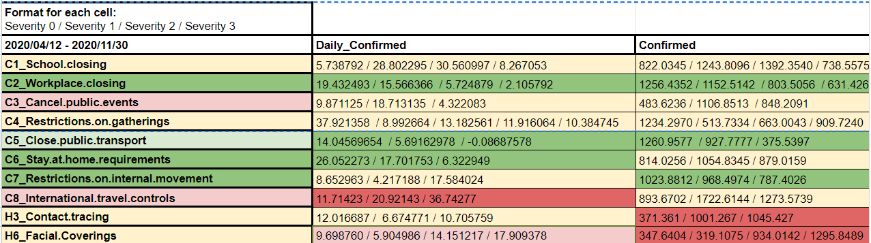
MODEL VALIDATION

Slide 43
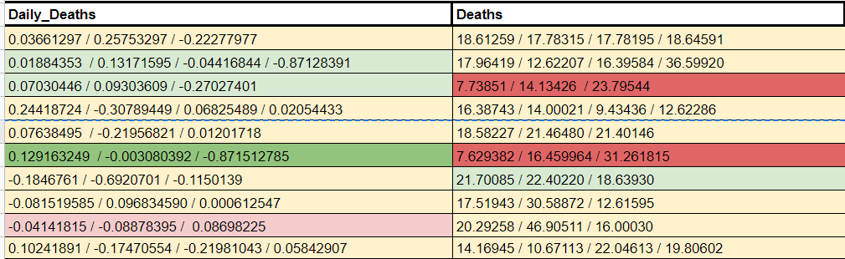
MODEL VALIDATION

Slide 44
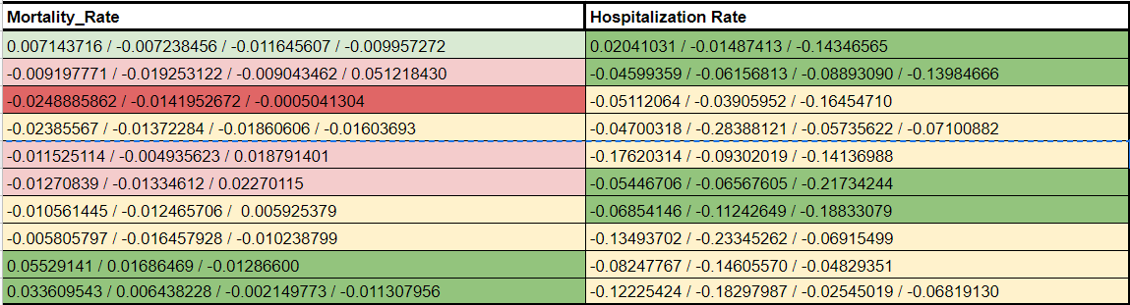
MODEL VALIDATION

Slide 45
MODEL VALIDATION
As we can see the table there are lot of variables which is from our model. The number is the slope of the policy. The column and rows are the statistics variable and sort of the predict variables. We also highlight the color for the elements because we define the color meaning below:
Green is meaning the slope is decreasing
Light green is meaning the slope is decreasing but not much
Yellow is meaning the slope is kind of horizontal or 0
Light red is meaning the slope is increasing but not much
Red is meaning the slope is increasing

Slide 46
MODEL VALIDATION
Let’s see the policy rows. We can compare the policy row for each other. We can see the Workplace closing policy and Stay at home requirements policy are very good policies because we can see they cover three columns in the table which the slope is decreasing.
The second good policy is Close public transport and Restrictions on internal movement. We can check the color. There is no increasing much and has two decreasing slopes which is very good for states.

Slide 47
MODEL VALIDATION
severity 0/1/2/3 | Daily_Confirmed | Confirmed | Hospitalization Rate
C2 Workplace Closing | 19.432493 / 15.566366 / 5.724879 / 2.105792 | 1256.4352 / 1152.5142 / 803.5056 / 631.4263 | -0.04599359 / -0.06156813 / -0.08893090 / -0.13984666
According to the data of C2 Workplace Closing, we can see that the Daily_Confirmed, Confirmed and Hospitalization Rate indicators have an obvious downward trend of slope, which means that some policies adopted by C2 are all effective in suppressing the spread of virus.
From the specific policy stage, for Daily_Confirmed, when the policy changes from severity 1(15.566366) to severity 2 (5.724879), the slope decreases most obviously.
As for the Confirmed index, when the policy changes from severity 1(1152.5142) to severity 2 (803.5056), the slope decreases more than other stages.
Therefore, from the overall data, although policies of severity 1, 2 and 3 all have an effective impact, the positive impact of severity 2 is the most obvious one.

Slide 48
MODEL VALIDATION
severity 0/1/2/3 | Daily_Confirmed | Daily_Deaths | Hospitalization Rate
C6_Stay at home requirements | 26.052273 / 17.701753 / 6.322949 | 0.129163249 / -0.003080392 / -0.871512785 | -0.05446706 / -0.06567605 / -0.21734244
According to the data of C6_Stay at home requirements, we can clearly see that the slope of Daily_Confirmed, Daily_Deaths and Hospitalization Rate is in a downward trend.
For Daily_Confirmed index, when the policy goes from none (26.052273) to severity 1 (17.701753) and then to severity 2(6.322949), the slope has an obvious downward trend, which shows that severity 1 and 2 are efficient policies for the Daily_Confirmed index.
From the Daily_Deaths index, we can find that the slope decline is the most obvious from severity 1 (-0.003080392) to severity 2( -0.871512785), which shows that severity 2 policy is the most efficient for Daily_Deaths index compared with other policy stages.
As for the Hospitalization Rate index, when the policy stage changes from severity 1( -0.06567605) to severity 2(-0.21734244), the slope has an obvious change, which shows that severity 2 is the most efficient policy .

Slide 49
MODEL VALIDATION
severity 0/1/2/3 | Confirmed | Hospitalization Rate
C7 Restrictions on internal movement | 1023.8812 / 968.4974 / 787.4026 | -0.06854146 / -0.11242649 / -0.18833079
According to the data of C7 Restrictions on internal movement, we can clearly see that the slopes of Confirmed and Hospitalization Rate are showing a downward trend, which means that the policies adopted by C7 are effective in suppressing the spread of virus.
According to the specific data, for the Confirmed index, the slope has dropped obviously from 968.4974 of severity 1 to 787.4026 of severity 2, so severity 2 has the most positive influence on the Confirmed index.
For Hospitalization Rate, It’s clear to see severity 1 and severity 2 have similar effects on Hospitalization Rate index, and they are both efficient policies.

Slide 50
CONCLUSION
Overall results were mixed
Workplace closings, stay-at-home orders, public transportation shutdowns, and internal movement restrictions were all associated with varying degrees of success..
Some results were unexpected
Cancelation of public events had negative consequences
Mask mandates showed mixed results
Recommendations for the future
Workplace closings and stay-at-home orders are superior options
Be careful generalizing, more research is needed!

Slide 51
BIBLIOGRAPHY / SOURCES
[1] R. C. Castillo, E. D. Staguhn, and E. Weston-Farber, “The effect of state-level stay-at-home orders on COVID-19 infection rates,” American Journal of Infection Control, vol. 48, no. 8, pp. 958–960, Aug. 2020, doi: 10.1016/j.ajic.2020.05.017.
[2] C. Courtemanche, J. Garuccio, A. Le, J. Pinkston, and A. Yelowitz, “Strong Social Distancing Measures In The United States Reduced The COVID-19 Growth Rate: Study evaluates the impact of social distancing measures on the growth rate of confirmed COVID-19 cases across the United States.,” Health Affairs, vol. 39, no. 7, pp. 1237–1246, Jul. 2020, doi: 10.1377/hlthaff.2020.00608.
[3] D. Dave, A. I. Friedson, K. Matsuzawa, and J. J. Sabia, “When Do Shelter-in-Place Orders Fight Covid-19 Best? Policy Heterogeneity Across States and Adoption Time,” Economic Inquiry, vol. n/a, no. n/a, doi: 10.1111/ecin.12944.
[4] M. E. V. Dyke, “Trends in County-Level COVID-19 Incidence in Counties With and Without a Mask Mandate — Kansas, June 1–August 23, 2020,” MMWR Morb Mortal Wkly Rep, vol. 69, 2020, doi: 10.15585/mmwr.mm6947e2.
[5] S. Hsiang et al., “The effect of large-scale anti-contagion policies on the COVID-19 pandemic,” Nature, vol. 584, no. 7820, Art. no. 7820, Aug. 2020, doi: 10.1038/s41586-020-2404-8.
[6] K. Luo et al., “Transmission of SARS-CoV-2 in Public Transportation Vehicles: A Case Study in Hunan Province, China,” Open Forum Infect Dis, vol. 7, no. 10, Oct. 2020, doi: 10.1093/ofid/ofaa430.
[7] C. R. MacIntyre and A. A. Chughtai, “A rapid systematic review of the efficacy of face masks and respirators against coronaviruses and other respiratory transmissible viruses for the community, healthcare workers and sick patients,” Int J Nurs Stud, vol. 108, p. 103629, Aug. 2020, doi: 10.1016/j.ijnurstu.2020.103629.
[8] K. Prem et al., “The effect of control strategies to reduce social mixing on outcomes of the COVID-19 epidemic in Wuhan, China: a modelling study,” The Lancet Public Health, vol. 5, no. 5, pp. e261–e270, May 2020, doi: 10.1016/S2468-2667(20)30073-6.
[9] E. Ziedan, K. Simon, and C. Wing, “Effects of State COVID-19 Closure Policy on NON-COVID-19 Health Care Utilization,” National Bureau of Economic Research, Cambridge, MA, w27621, Jul. 2020. doi: 10.3386/w27621.
[10] First dataset idea: https://c3.ai/products/c3-ai-covid-19-data-lake/
[11] Daily state reports: https://github.com/CSSEGISandData/COVID-19
[12] Initial State policies: https://github.com/KFFData/COVID-19-Data/tree/kff_master/State%20Policy%20Actions/State%20Social%20Distancing%20Actions
[13] State policies: https://github.com/OxCGRT/USA-covid-policy

